Slide 1
UNIT-I Importance of Information System CAP404 INFORMATION SECURITY AND PRIVACY
SCHOOL OF COMPUTER APPLICATIONS
DOMAIN: AI &ML

Slide 2
Importance of Information Systems
Improves decision-making by providing accurate and timely information.
Increases efficiency through automation of routine tasks and processes.
Enhances communication within organizations and with customers or partners.
Supports business operations such as inventory, sales, finance, and employee management.
Provides a competitive advantage by improving productivity, innovation, and customer service.

Slide 3
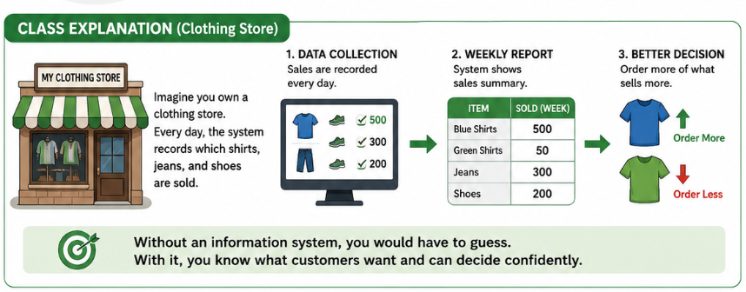
1. Improves Decision-Making

Slide 4
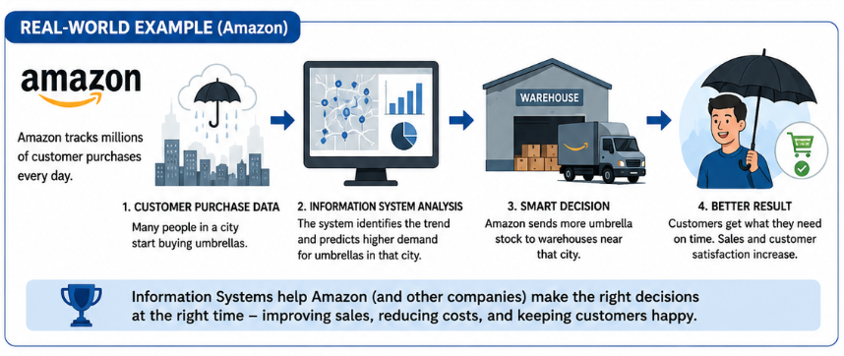
Cont.

Slide 5
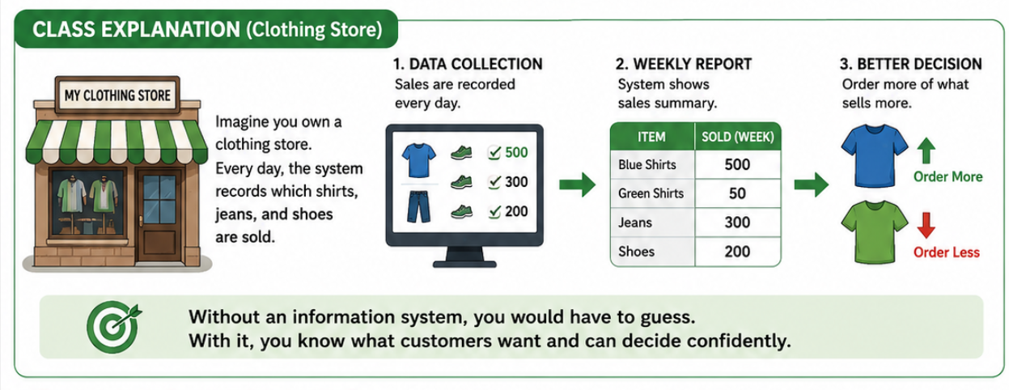
2. Increases efficiency through automation

Slide 6
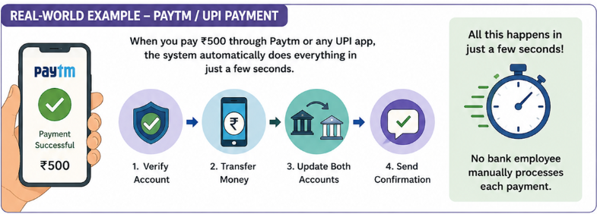
Cont.

Slide 7
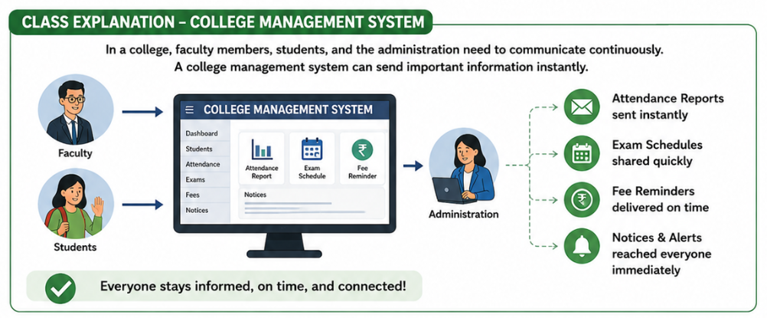
3. Enhances Communication

Slide 8
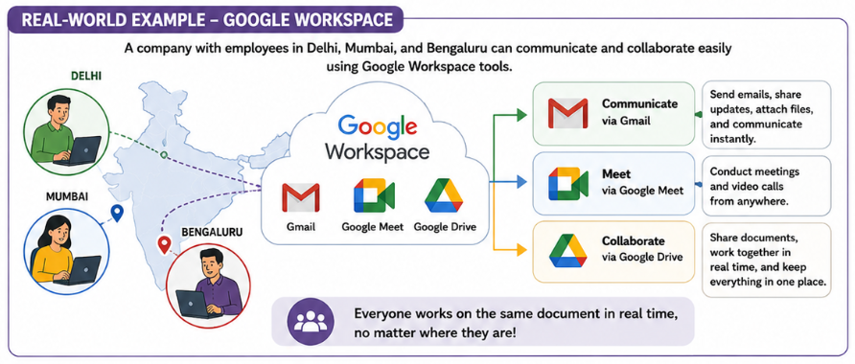
Cont.

Slide 9
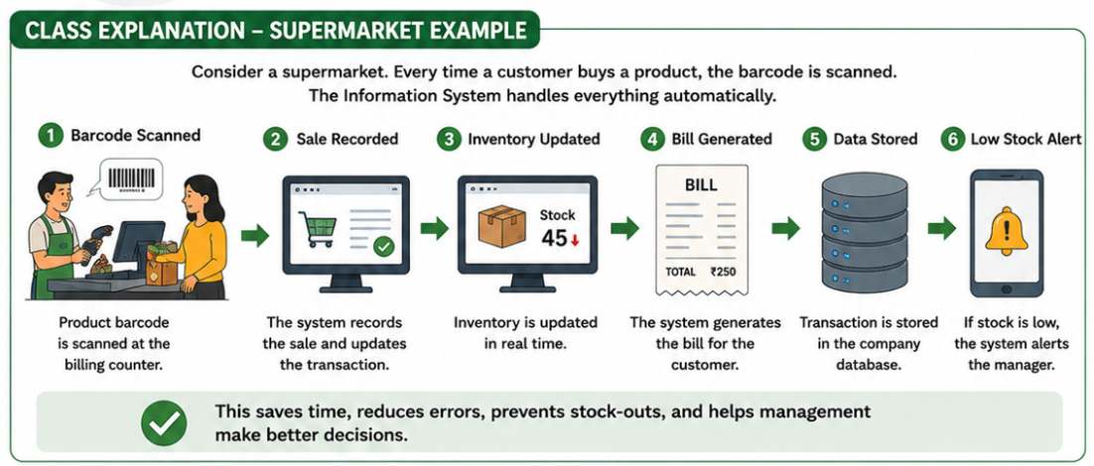
4. Supports Daily Business Operations

Slide 10
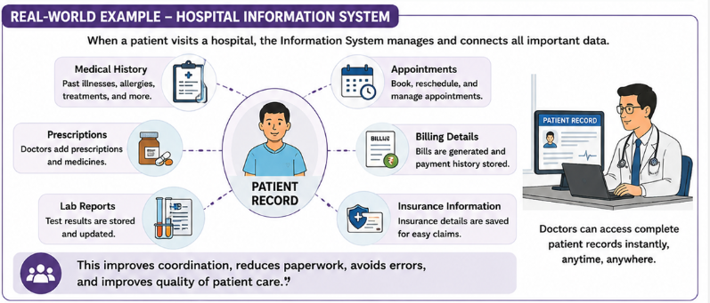
Cont.

Slide 11
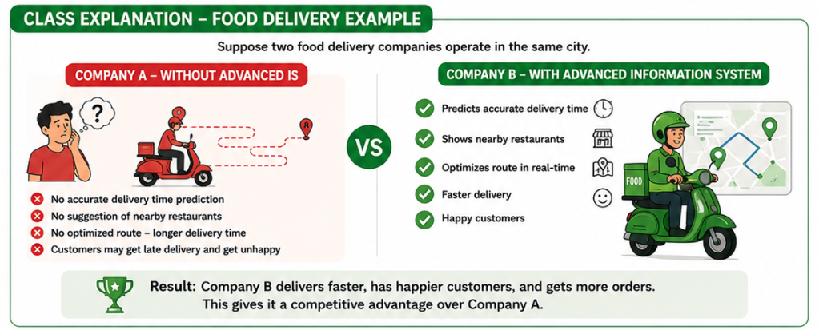
5. Provides Competitive Advantage

Slide 12
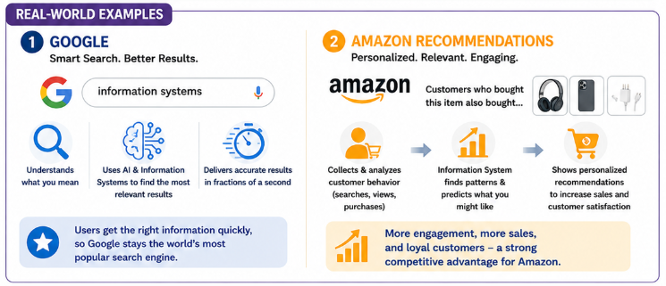
Cont.

Slide 13
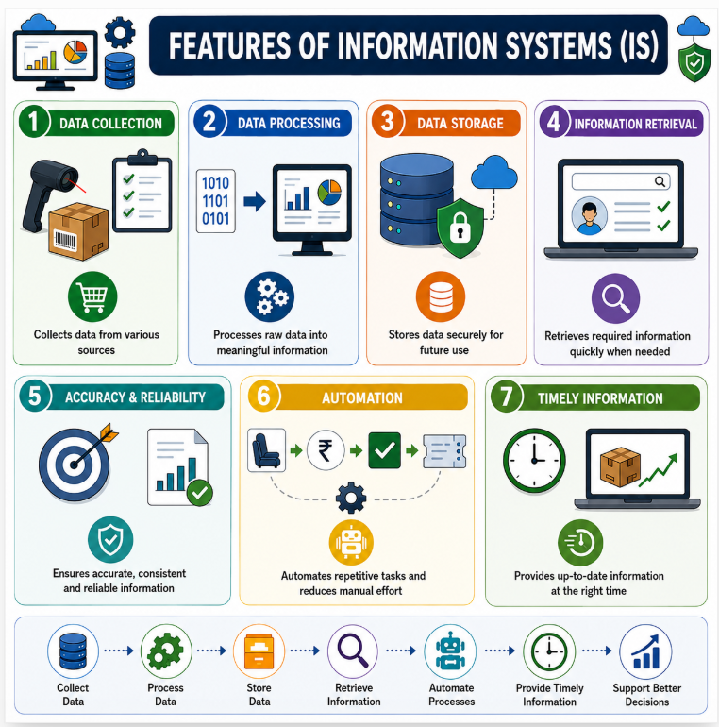

Slide 14
Which sequence correctly represents the logical flow of information within most Information Systems?
A. Retrieval → Collection → Storage → Processing
B. Collection → Processing → Storage → Retrieval
C. Processing → Collection → Retrieval → Storage
D. Storage → Collection → Processing → Retrieval

Slide 15
A university system automatically generates attendance reports from daily biometric scans. Which combination of features is involved?
A. Data Collection and Data Processing
B. Data Storage and Information Retrieval
C. Automation and Timely Information only
D. Accuracy & Reliability only

Slide 16
Which feature enables organizations to respond rapidly to changing market conditions?
A. Data Storage
B. Timely Information
C. Information Retrieval
D. Data Collection

Slide 17
Which statement best distinguishes Data Processing from Information Retrieval?
A. Processing stores data permanently, while retrieval deletes data.
B. Processing transforms raw data into information, while retrieval accesses stored information when needed.
C. Processing collects data from users, while retrieval validates data accuracy.
D. Processing automates tasks, while retrieval provides timely information only.

